Slide 1
TrashID
The Real TBD
David Burgos, Jeremy Pan, Catherine Wang, Jessica Yeh, and Zane Zmola

Slide 2

TrashID Systems

Slide 3
What is TrashID?
TrashID is a system used for consumers to monitor their waste habits by identifying what they throw out
TrashID uses image processing AI to identify what items are thrown out
Items are logged and used to present waste composition to consumers
Advice is given to consumers to minimize their environmental impact

Slide 4
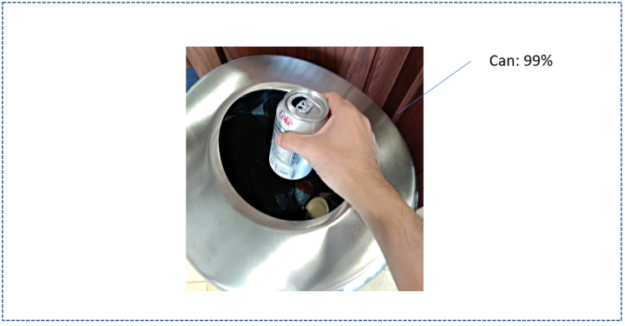
TrashID process
Sign up for service
Set up trash can with camera
Toss trash into can
Image recognition of item -> sends to SQL database
User logs into website
User sees stats

Slide 5
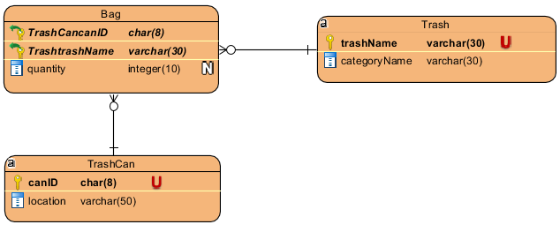
Entity Relationship Diagram

Slide 6
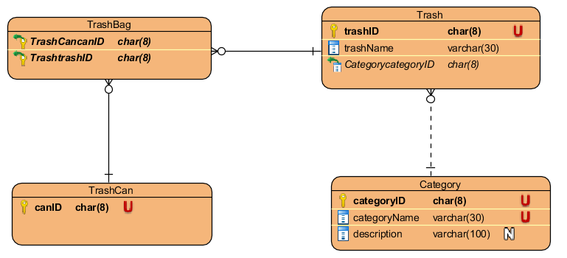
Iterative Entity Relationship Diagram

Slide 7
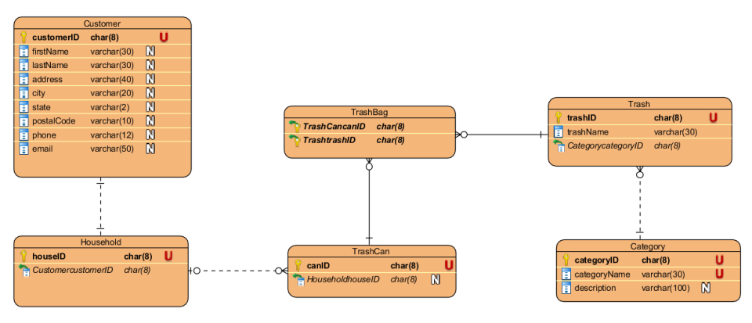
Entity Relationship Diagram (with scaled architecture)

Slide 8
Price estimation
Hands Free trash can
Kitchen Cabinet Installation
Item | Est Cost (USD)
Trash can | 13
camera | 20
Wireless Transmitter | 2
General Materials (connectors, battery, etc) | 15
Labor | 25
Total | 75$
Item | Est Cost (USD)
Cabinet | 200+
camera | 20
Wireless Transmitter | 2
General Materials (connectors, battery, etc) | 25
Labor | 50
Total | 297+$

Slide 9
Sources
COCO database- AI training resources
The Construct Sim - tutorials for ROS coding
Freepik.com-generic symbols,banana outline

